Slide 1
BertScore: Evaluating Text Generation With Bert
Yuye Zhu

Slide 2
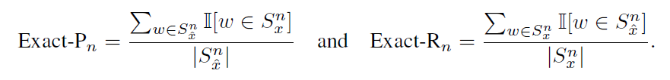
N-Gram Matching Approaches
The exact match Precision (Pn) and Recall (Rn) scores are:
Q: What is the Precision and Recall score?
I ran because I was afraid.
I was afraid because I ran.

Slide 3
N-Gram Matching Approaches
The exact match Precision (Pn) and Recall (Rn) scores are:
Q: What is the Precision and Recall score?
I ran because I was afraid.
I was afraid because I ran.
1

Slide 4
Shortcomings
Semantically-correct phrases maybe penalized
People like foreign cars.
People like visiting places abroad.
Consumers prefer imported cars.
Fail to penalize semantically-critical ordering changes
I ran because I was afraid.
I was afraid because I ran.

Slide 5
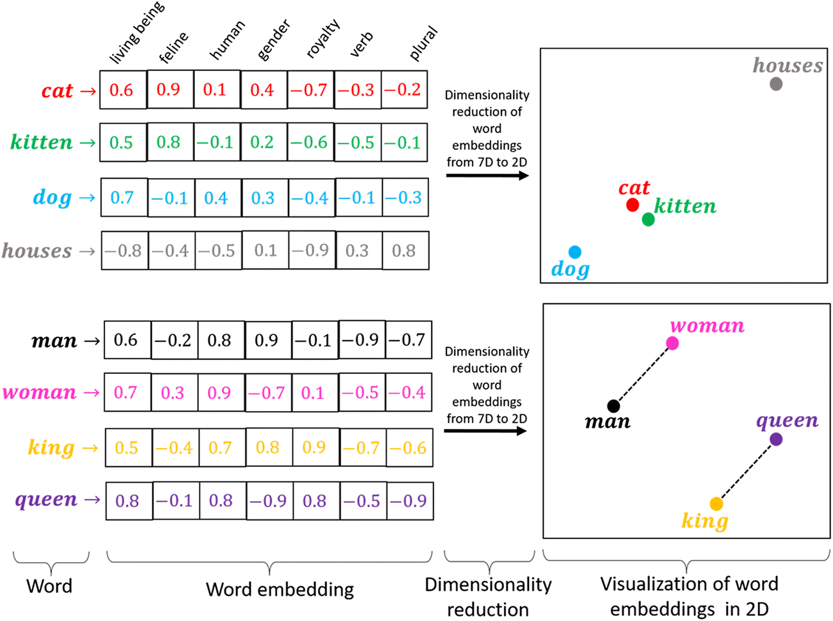
Word Embedding

Slide 6
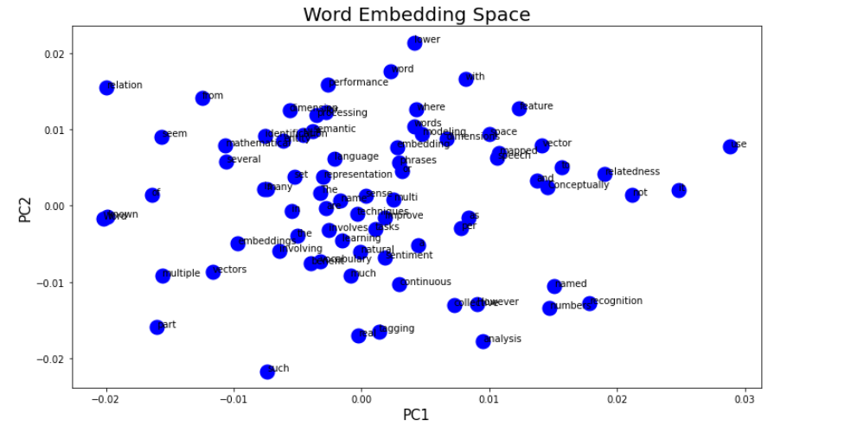
Word Embedding

Slide 7
Word Embedding
Q: How to represent the similarity between two words?

Slide 8
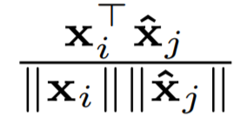
Word Embedding
Q: How to represent the similarity between two words?
A: Cosine Similarity

Slide 9
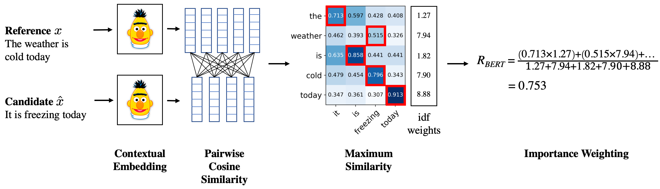
BERTScore

Slide 10
BERTScore
Why the cosine similarity is not 1?

Slide 11
BERTScore
Contextual Embedding

Slide 12
BERTScore

Slide 13
BERTScore
Any Problems?

Slide 14
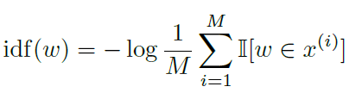
Inverse Document Frequency (Optional)

Slide 15
Inverse Document Frequency (Optional)
Q: Frequent word
IDF should be high/low?

Slide 16
Inverse Document Frequency (Optional)
Q: Frequent word
IDF should be low

Slide 17
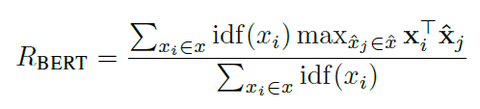
Inverse Document Frequency (Optional)

Slide 18
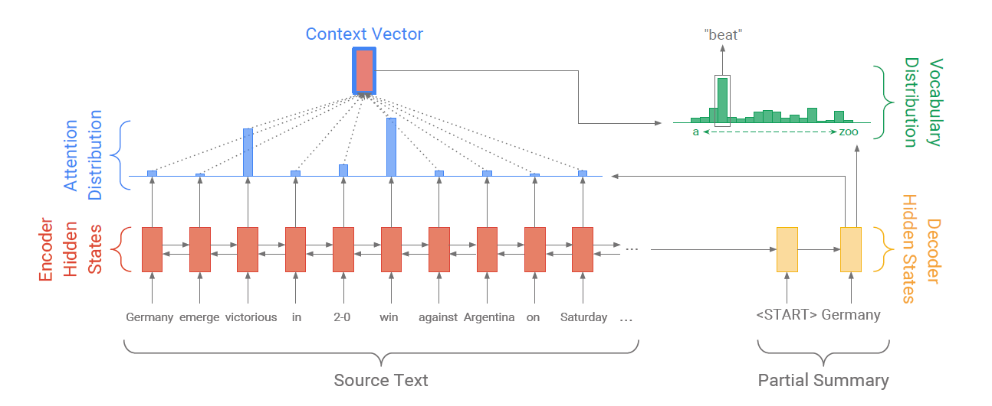
RNN-Based Generation Model

Slide 19


RNN-Based Generation Model

Slide 20
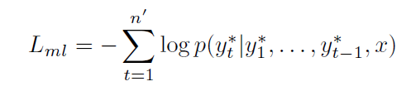
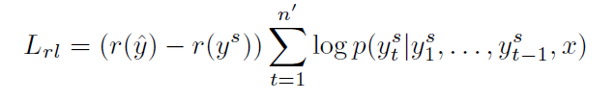
Reinforcement Learning
Machine Learning: maximum-likelihood training objective
Reinforcement Learning:

Slide 21
Conclusion
Based on models
Capture semantic feature
Fully differentiable->Learning Loss
Future: Designing new task-specific metrics

